Slide 1
Reactions 13
Neutron capture in light nuclei
Photonuclear reactions

Slide 2
















Slide 3











Slide 4



























Slide 5






























⁹₂₇Co + n → ⁶⁰₂₇Co → ⁶⁰₂₈Ni + e⁻ + 2 γ

Slide 6
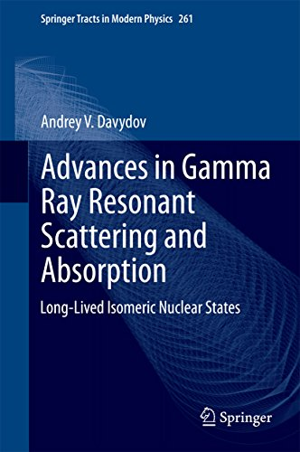




























Ann N Y Acad Sci. 2000 May:904:229-35. doi: 10.1111/j.1749-6632.2000.tb06458.x.
Gamma resonance absorption. New approach in human body composition studies
L Wielopolski et al.

Slide 7
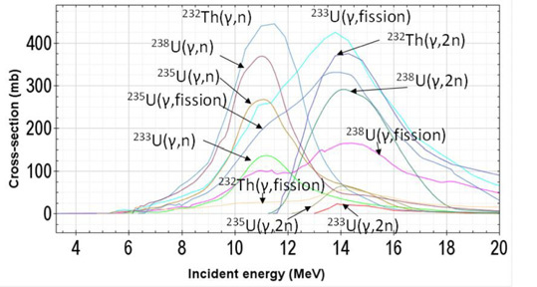
Note higher thresholds for 2n emission

Slide 8
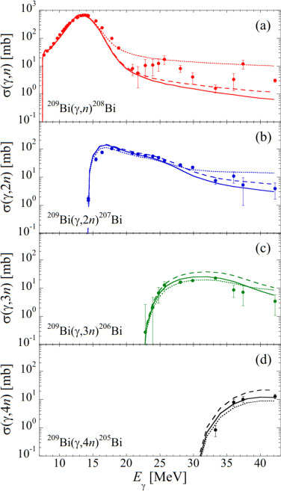














Progress in Particle and Nuclear Physics
Volume 122, January 2022, 103903
Progress in Particle and Nuclear Physics
Review
Photonuclear reactions—From basic research to applications

Slide 9
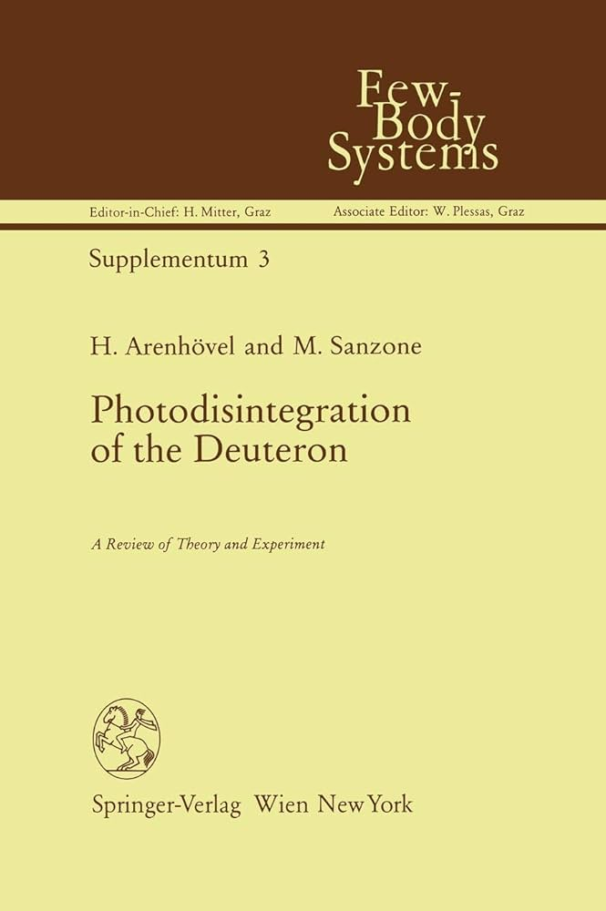
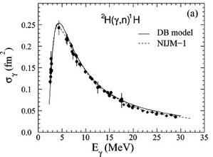
















Slide 10

































Slide 11




































Slide 12





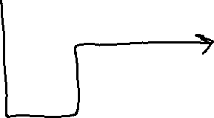
























Slide 13

















Slide 14





























Slide 15





























Slide 16






















Slide 17




















Slide 18











Slide 19







